Slide 1
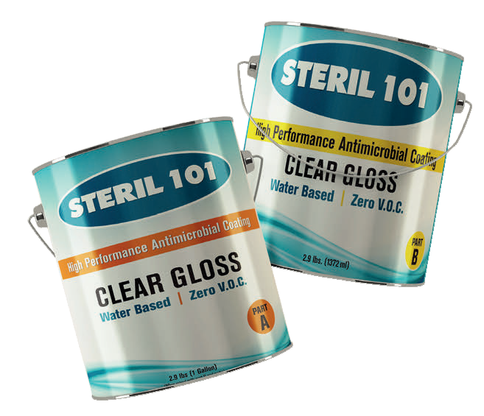
Eliminates 99.999% of a Wide Range of Bacteria & Viruses
Who We Are
What We Do
The Product Data
Easy to use
Why STERIL 101 is different
Protective Coating
Target Market
Cost Savings
Study Reports
H1N1
Listeria
Salmonella
CRE
Pseudomonas
MRSA
Bacteria

Slide 2
Who we are - What we do -
Bio Care Tech has been established by three people from different backgrounds with the same core values to safe life. A Medical Doctor, a Scientist, and a Management, who all have concern for the safety of human life regarding todays issues with infectious diseases.
We specialize in enhancing the technology of Antimicrobial with zero V.O.C (Volatile Organic Compound) in a water-based solution.
Bio Care Tech has developed an environmentally green product in a high-performance protective coating with excellent antimicrobial properties that eliminate MRSA, Pseudomonas, Acinetobacter, CRE, C. Auris and H1N1.

Slide 3
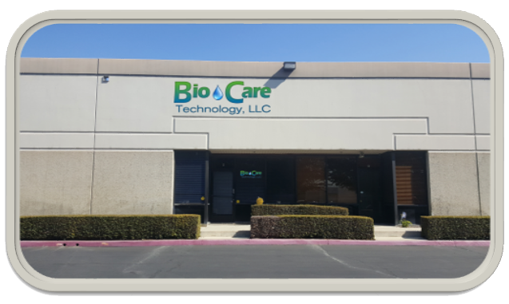
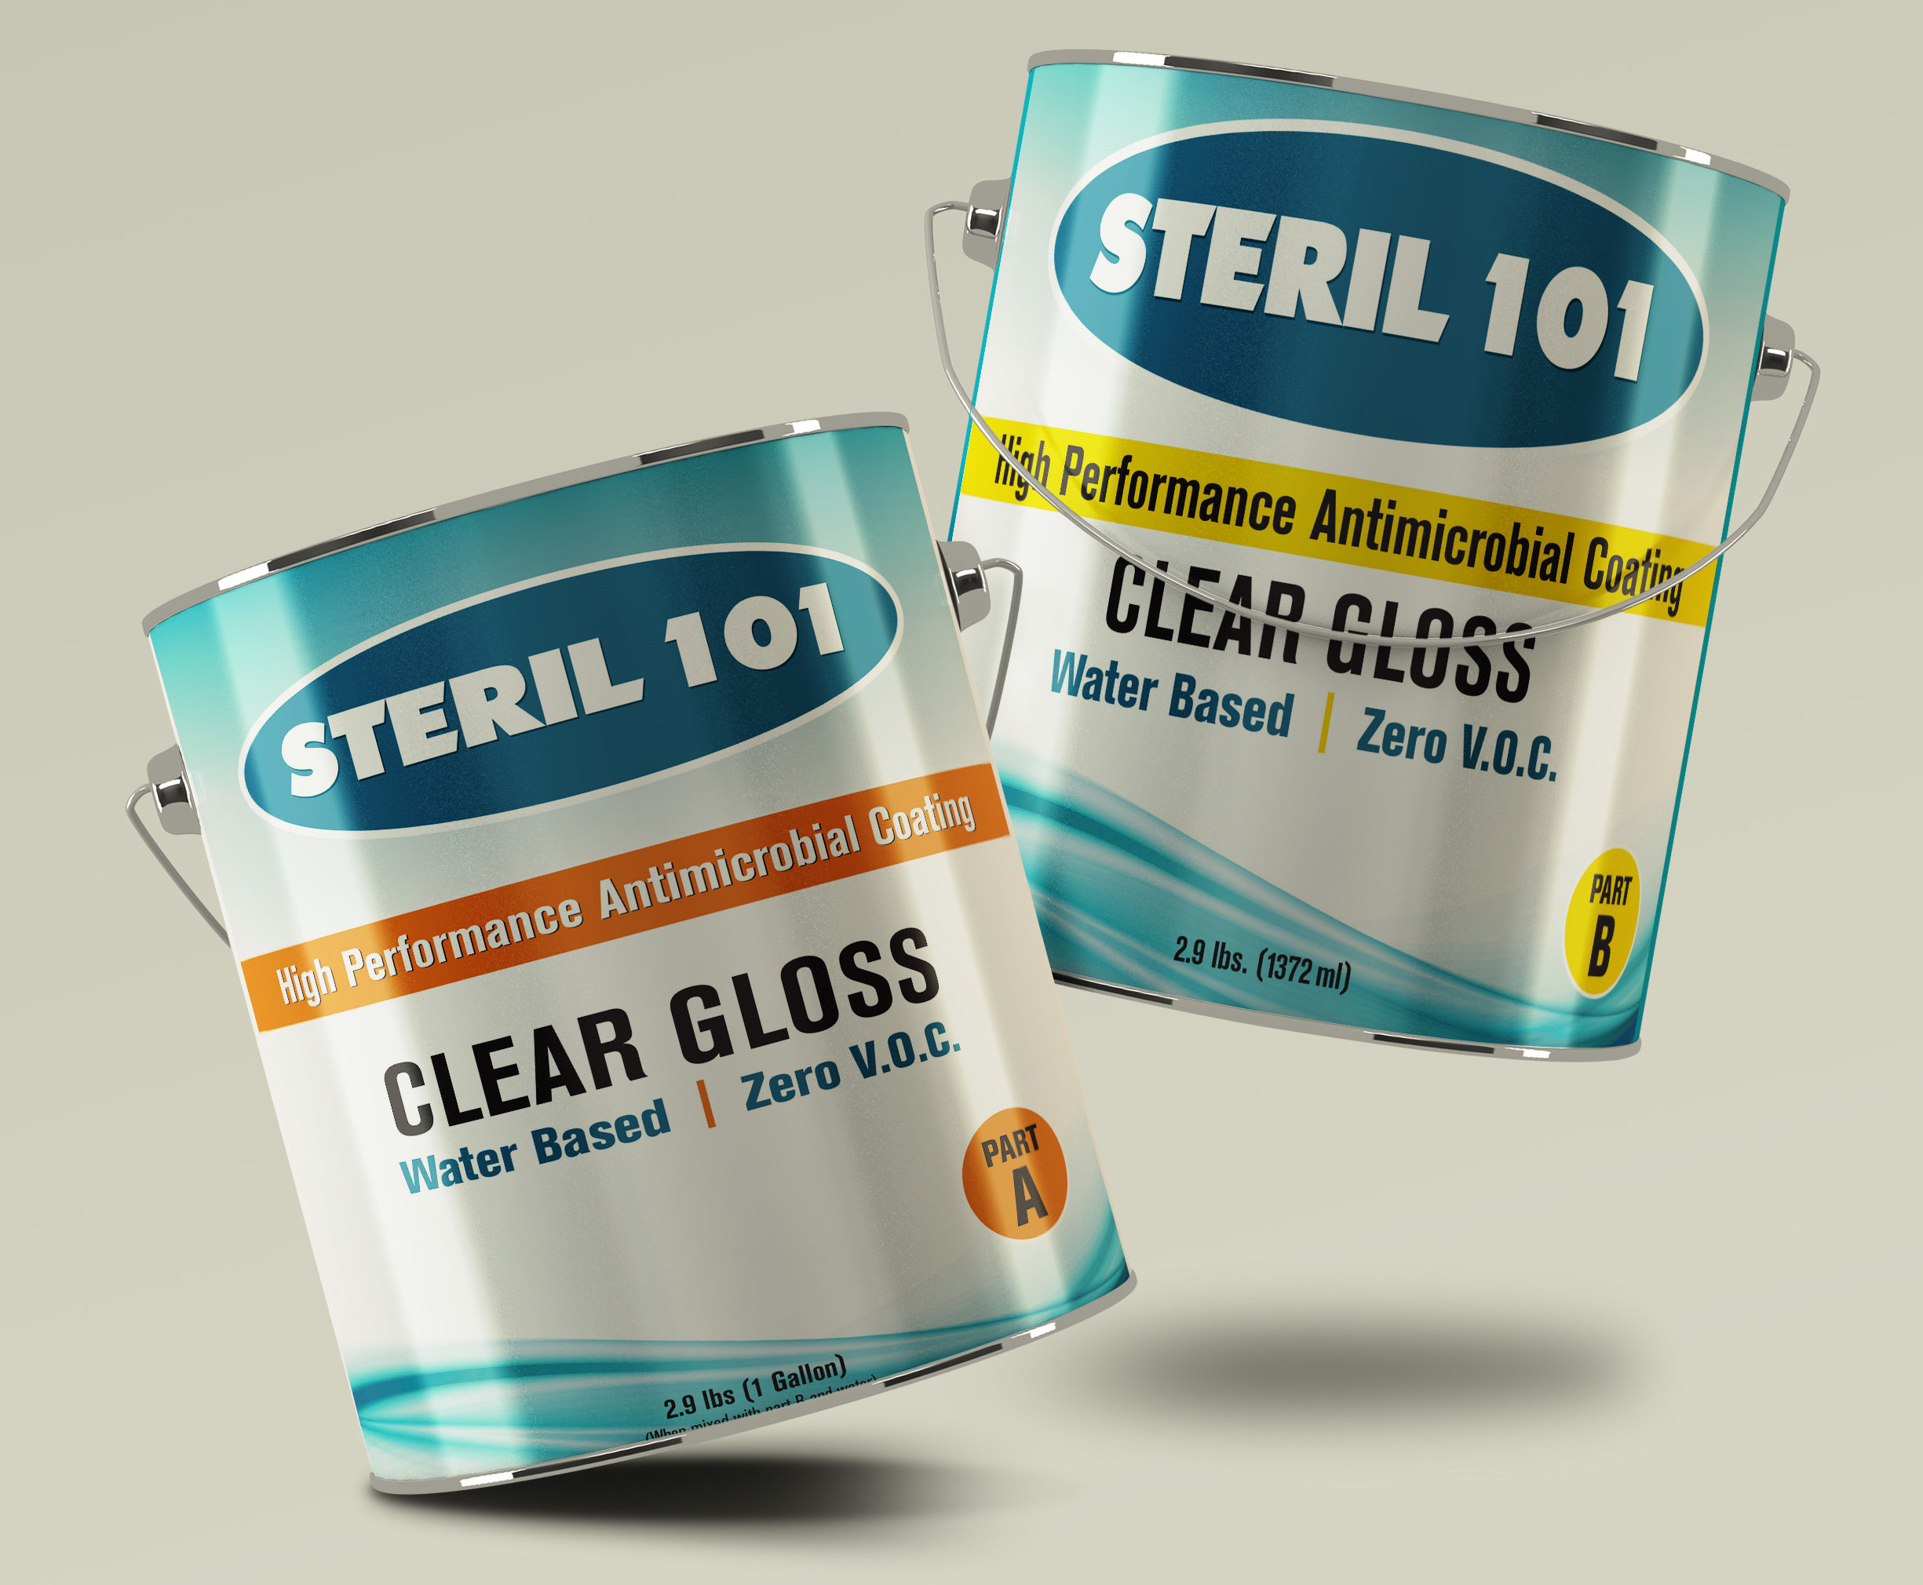
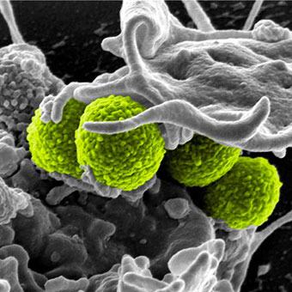
Company | Office | Product | Against Bacteria | Water Base Coating
 | 1701 S. Grove Ave. Suite H Ontario, CA 91761 | Anti Microbial Protective Coating | MRSA, CRE, H1N1, Pseudomonas, Acinetobacter | Green Environmental Safe
High Performance Anti Microbial Coating |  |  |  | Zero V.O.C No Odor

Slide 4
Steril 101 High Performance Antimicrobial Coating
Steril 101 is a high-performance protective coating with excellent antimicrobial properties. Steril 101 has been tested by an independent antimicrobial testing laboratory with results showing excellent ability in eliminate the growth of a wide range of bacteria, viruses.
An example of its effectiveness can be illustrated with test results against “MRSA” Methicillin Resistant Staph Aereus in which the elimination percentage was 99.9995% staph.
4

Slide 5
Steril 101 High performance Antimicrobial Coating
Steril 101 is a two-component aliphatic polymer. It is water based and zero V.O.C. (volatile organic compound) with no odor. It cures to a tough high gloss finish with excellent mar and scratch resistance. Steril 101 is also chemical and acid resistant with excellent non-yellowing properties.
Steril 101 meets and or exceeds the California green building standard codes for regulation title 24, part II and, also meets U.S. building council leads criteria under E.Q. 4.2 for low emitting paints and coatings. The antimicrobial active ingredients are FDA approved.

Slide 6
Product Data - uncured
Solid By Weight 63%
Solid By Volume 56%
V.O.C. 0%
Application Rate250 to 350 SQFT / Gallon
Dry time to touch after 7 hours
Pot Life / Working Time 1 ½ hours
Shelf Life 12 months
Flash Point
Greater than 200 degree Fahrenheit

Slide 7
Performance Data - fully cured
Adhesion ASTM D4541 - 2800 Psi
Adhesion to aluminum cross batch test 5 cycle - 0 Loss
Impact resistance ASTM D2794
- 160 inch per pounds (direct / reverse)
Flexibility ASTM D522 - Elongation greater than 30%
Pencil Hardness ASTM D3363 - Gouge 4 H
MEK Double Rubs - 2000+
Water Vapor Transmission - 2.3 Perms
Chemical Acid Resistant - Excellent
Antimicrobial resistant, Japanese Industrial Standard Z 2801 test method
- Eliminates 99.4% MRSA in 1 hour
24 hours Immersion in water - No effect, Pass

Slide 8
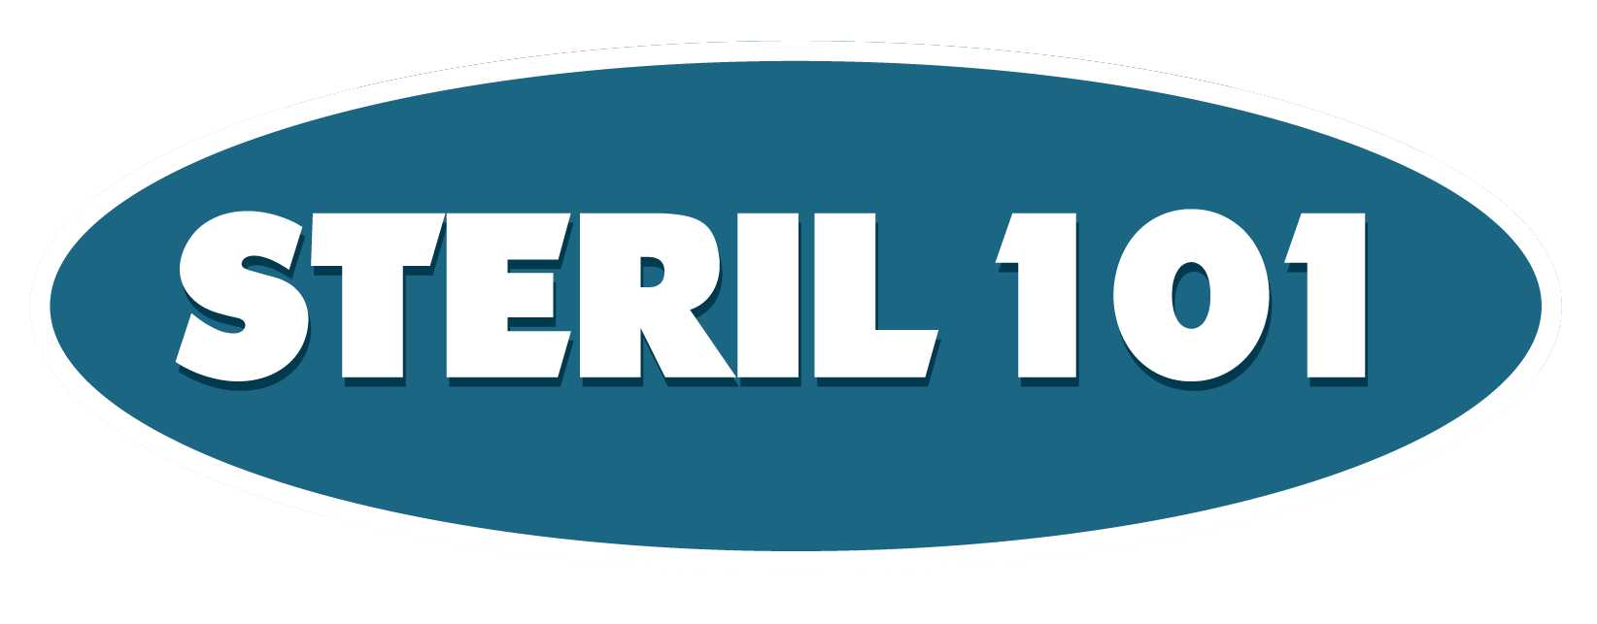
Proven and tested to eliminate:
MRSA
C - Auris
Pseudomonas
H1N1 Flu Virus
CRE
Baumanii
Lesteria
Salmonella
Mold and Mildew
Proven and tested by credential independent laboratory MicroChem
Visit our website www.biocaretechusa.com to download all the study reports to see how incredibly Steril 101 is able to eliminate bacteria and viruses up to 99.97% and one coat lasts for 3 years

Slide 9
tested on floor Materials And Walls
Anti Slip
Easy to Apply
Non-Toxic
Easy to maintain
Green Eco Friendly
Non yellowing
Application rate 250 to 300 sqft
Drying time 7 hour, last 3 years
Chemical Acid Resistance
MEK Double Rubs
Adhesion ASTM D4541
Impact Resistance D2794
Flexibility ASTM D522
Pencil Hardness ASTM D3363
Water Vapor Transmission
Antimicrobial Resistant, Japanese Industrial Standard Z 2801 method
24 hours Immersion in Water

Slide 10
How do I use Steril 101
Simple and E.Z
These are two-part systems consisting of part A mixed with part B. After A & B are mixed, the product can be reduced with water up to 50%.
The application method is with a brush, roller or spray and it’s suggested application rate is approximately 250 to 300 square feet per gallon. Most applications only require one coat.
Drying Time 7 hours (depending on room temperature)
Steril 101 will also perform as an excellent anti graffiti coating.

Slide 11
Why Our Products Different Than Any Other Protective Coating
Steril 101
Other Protective Coating
High Performance Antimicrobial Coating
In Total Water Solution
Zero V.O.C. (Volatile Organic Compounds)
Green Eco Friendly
Eliminate 99.99% of Gram positive and negative bacteria
One coat last for 3 years
No Zero V.O.C
No Water Based
No Other Product Reducible Up To 50%. Just Water

Slide 12
Steril 101 IS SIMPLY
Invented to save lives
Designed as Green Product for friendly environment
Beautiful in finish performance without changing your room design or color
Clean, glossy finish or matte as your choice
Zero V.O.C (Volatile Organic Compound)
Eliminate 99.99% of Gram positive and negative bacteria ( Proven and Tested by Credential Independent Lab, results can be found on our website www.biocaretechusa.com)

Slide 13
Target Market
Health Care Facilities
Education Facilities
Childcare Facilities
Public Areas
Cruise Ships
Offices
Homes
Food Plant Industries
Gyms

Slide 14
Cost Savings Case Sample : Hospital Floor
Will eliminate every 3-6 months, strip & waxing the floor for saving
The Annual nationwide cost to treat hospitalized patients with MRSA infections is estimated to be between $3.2 billions to $4.2 billions. (Infectious Control Today)
Each Case of MRSA hospital infection cost additional $61,000 each to treat (About Lawsuit.com)
MRSA infection is independently associated with an almost 50% higher likelihood of hospital death compared with MSSA infection (Int. J. Antimicrob. Agents)
Steril 101
One time Coating last for 3 years and eliminates bacteria and viruses as well as high Gloss floor.

Slide 15
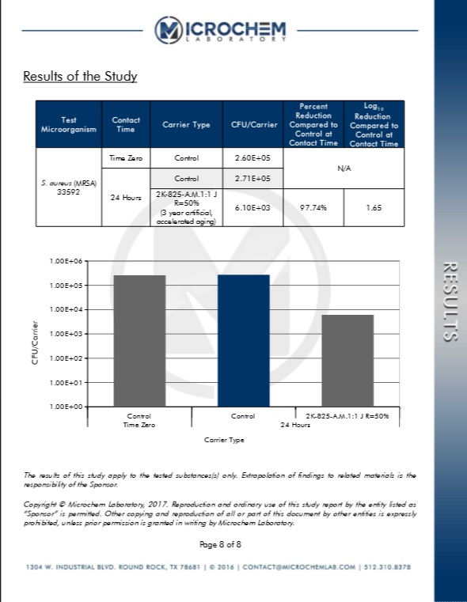
Proof of Study Report
Eliminate 97.74% of MRSA Bacteria
(3 Year Artificial Accelerated Aging)

Slide 16
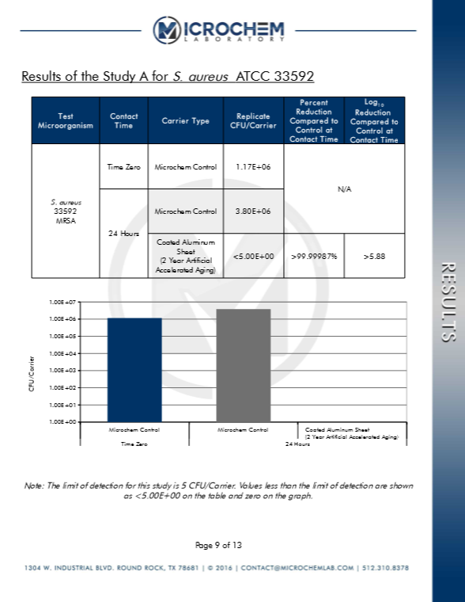
Proof of Study Report
Eliminate 99.99987% of MRSA Bacteria
(2 Year Artificial Accelerated Aging)

Slide 17
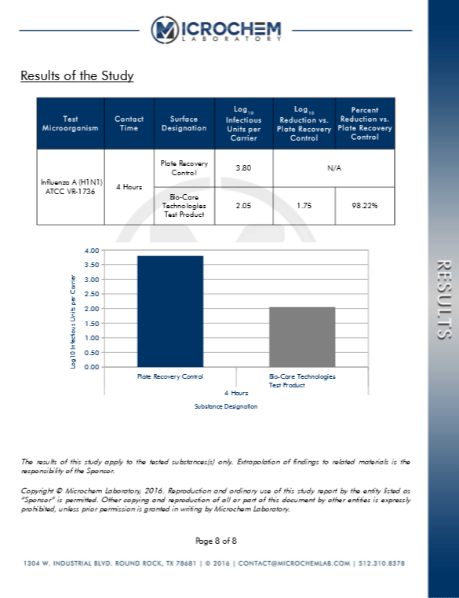
Proof of Study Report
Eliminate 98.22% of H1N1 Virus in 4 hours

Slide 18
Proof of Study Report
Eliminate 99.9997% Pseudomonas Aeruginosa
(3 Year Artificial Accelerated Aging)

Slide 19
Proof of Study Report
Eliminate 99.9999% of A. Baumannii
(3 Year Artificial Accelerated Aging)

Slide 20
Proof of Study Report
Eliminate 99.97% of E.Cloacae (CRE)
(3 Year Artificial Accelerated Aging)

Slide 21
Proof of Study Report
Eliminate 99.97% of C. Auris

Slide 22
Proof of Study Report
Eliminate 99.40% of A. Brasiliensis

Slide 23
Steril 101 Case Study Report
The Only One High Performance Concentrate Antimicrobial Clear Permanent Coating with Real Active Ingredients and Water Based
2017

Slide 24
Recent Events
California Senator Jerry Hill plan to introduce a bill to require California hospital to report infected with superbug CRE.
Global leaders met at the United Nations General Assembly in New York in September 2016 to commit to fighting antimicrobial resistance together. This was only the fourth time in the history of the UN that a health topic is discussed at the General Assembly.
Jim O'Neill, (former Goldman Sachs Group, Economist)in London, chaired a commission that said without policy changes to combat drug resistance, an estimated $100 trillion in economic output could be put at risk by 2050.
the World Bank said drug-resistant infections could cause global economic damage comparable to the 2008 financial crisis. Under a worst-case scenario, the bank projects that low-income countries could lose more than 5 percent of their GDP and that up to 28 million people, mostly in developing countries, could be pushed into poverty by 2050.
An estimated 700,000 people die every year from drug-resistant infections, according to the British commission review. Without policies to halt the spread of this resistance, the toll could soar to 10 million additional deaths annually by 2050, or one person every three seconds, according to the commission review. That’s more than the number of people now killed each year by cancer

